Slide 1
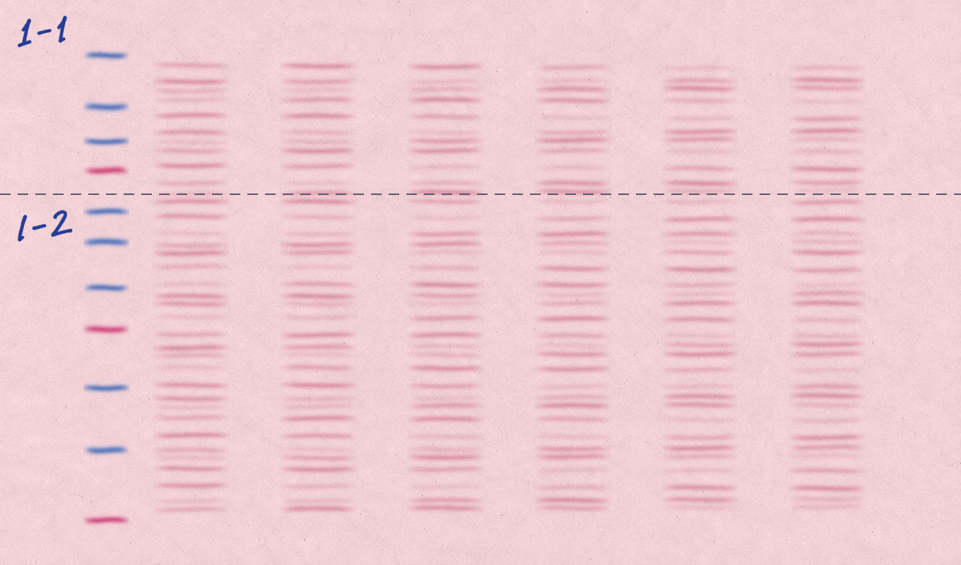

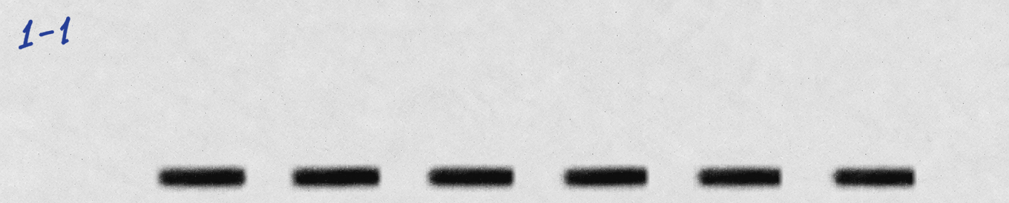
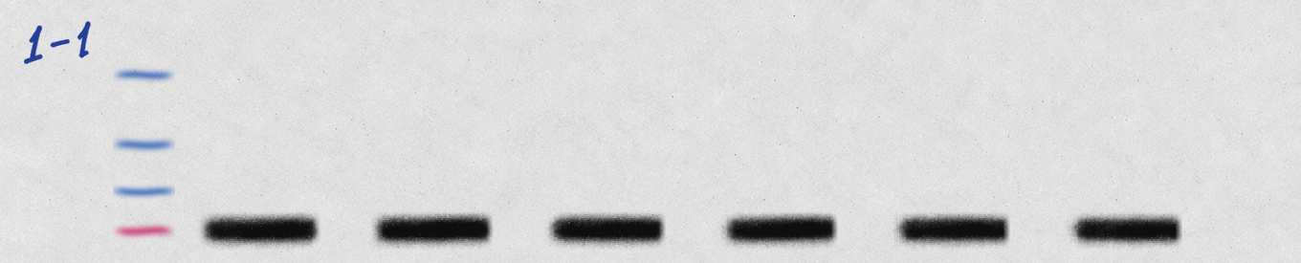

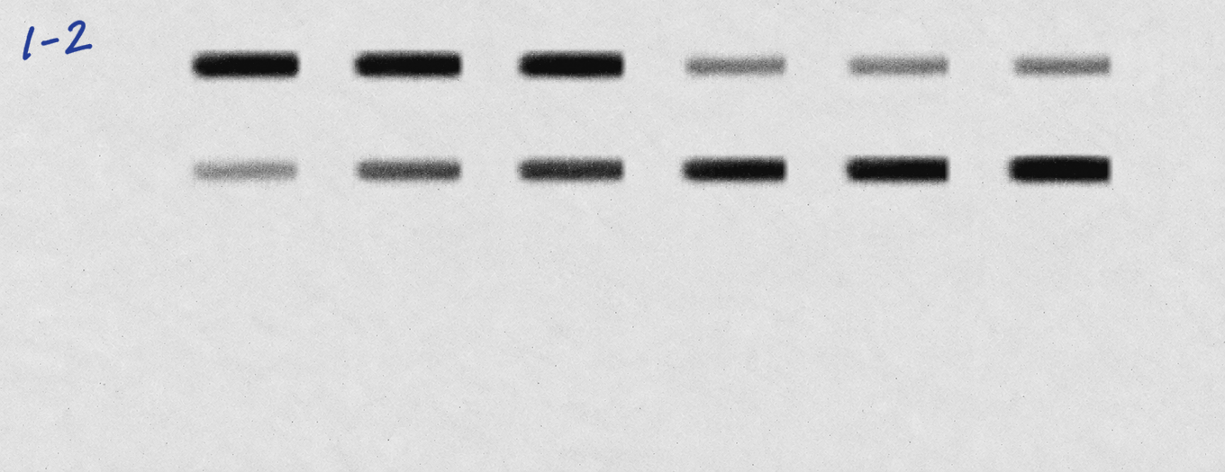
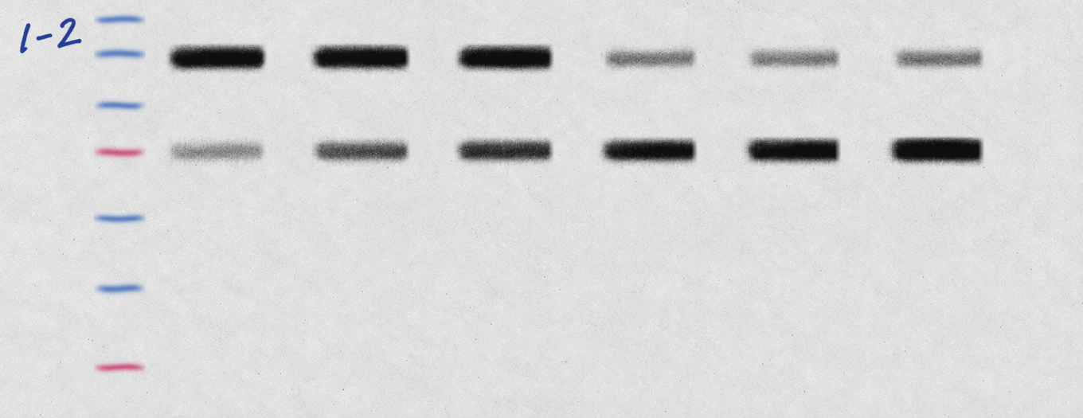
Treatment
Protein
White light and marker
Target: Chemiluminescence image
Target: Overlay image
Whole-membrane photo
HSP90
GSDMD
1 / 1 Targets 1–2 / 2

